Slide 1


STUDENT NAME:M.Amina Shafrin
STUDENT ID:au951221104003
COLLEGE NAME:JP College of Engineering

Slide 2
Voting System Project Using Django Framework
DJANGO

Slide 3
PROJECT OVERVIEW
This application will conduct a series of questions along with many choices.
A user will be allowed to give voting for that question by selecting a choice.
Based on the answer the total votes will be calculated and it will be displayed to the user.
Users can also check the result of the total votes for specific questions on the website directly.
Admin user will be allowed to add questions and manage questions in the application.

Slide 4
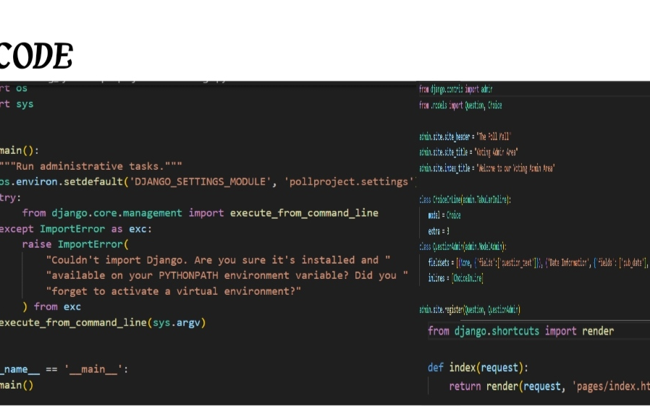

Slide 5
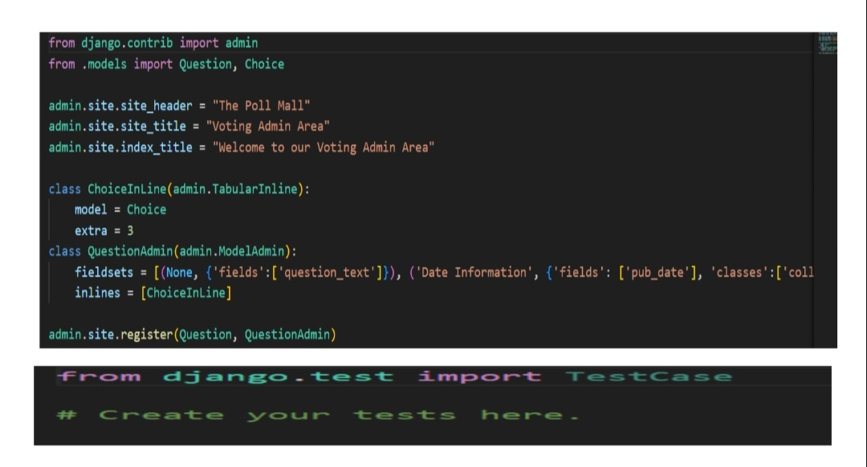

Slide 6
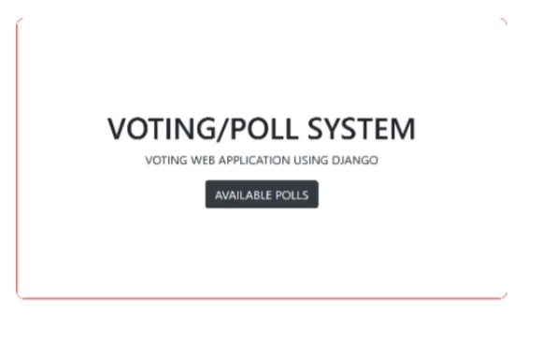

Slide 7
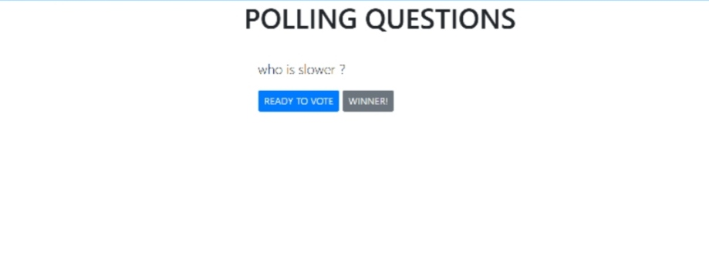

Slide 8
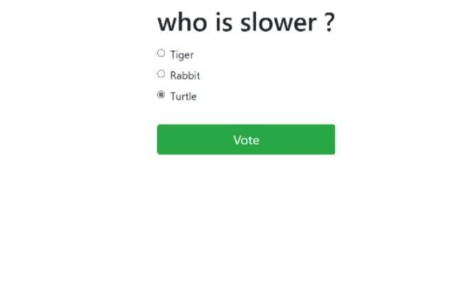

Slide 9
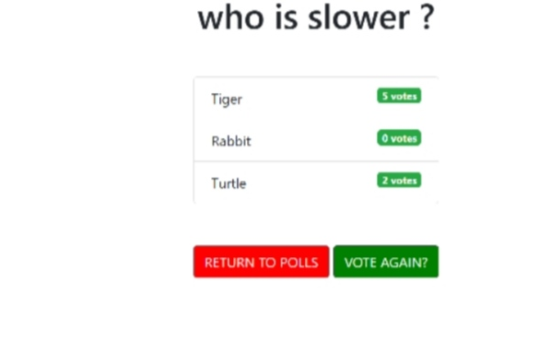

Slide 10
Thank you

